Slide 1
Concurrency in Kernel

Slide 2
Concurrency = Things happening at same time
Source of Concurrency in Linux
Multiple processors
Hardware Interrupts
Software Interrupts
Kernel timers
Work queue
Kernel Preemption
Failure to Manage concurrency leads to bugs
Difficult to track down

Slide 3
Concurrent processes
Consider two examples having separate tasks running independently but sharing data
Difficult to write system using sequential program model
Concurrent process model easier
Separate sequential programs (processes) for each task
Programs communicate with each other
Heartbeat Monitoring System
B[1..4]
Heart-beat pulse
Task 1:
Read pulse
If pulse < Lo then
Activate Siren
If pulse > Hi then
Activate Siren
Sleep 1 second
Repeat
Task 2:
If B1/B2 pressed then
Lo = Lo +/– 1
If B3/B4 pressed then
Hi = Hi +/– 1
Sleep 500 ms
Repeat
Set-top Box
Task 1:
Read Signal
Separate Audio/Video
Send Audio to Task 2
Send Video to Task 3
Repeat
Task 2:
Wait on Task 1
Decode/output Audio
Repeat
Video
Audio
Input Signal
Task 3:
Wait on Task 1
Decode/output Video
Repeat
<number>

Slide 4
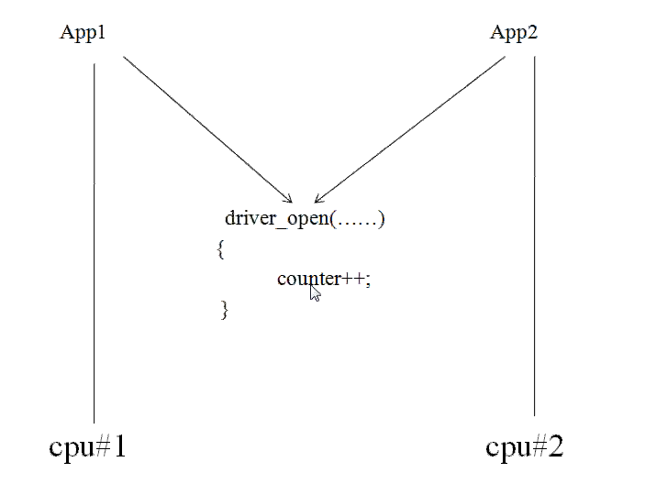

Slide 5
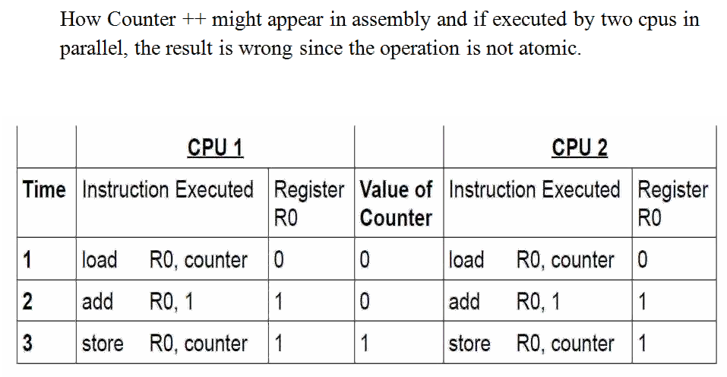

Slide 6
Correct Shared Memory Solution to the Consumer-Producer Problem
The primitive mutex is used to ensure critical sections are executed in mutual exclusion of each other
Following the same execution sequence as before:
A/B execute lock operation on count_mutex
Either A or B will acquire lock
Say B acquires it
A will be put in blocked state
B loads count (count = 3) from memory into register R2 (R2 = 3)
B decrements R2 (R2 = 2)
B stores R2 back to count in memory (count = 2)
B executes unlock operation
A is placed in runnable state again
A loads count (count = 2) from memory into register R1 (R1 = 2)
A increments R1 (R1 = 3)
A stores R1 back to count in memory (count = 3)
Count now has correct value of 3
01: data_type buffer[N];
02: int count = 0;
03: mutex count_mutex;
04: void processA() {
05: int i;
06: while( 1 ) {
07: produce(&data);
08: while( count == N );/*loop*/
09: buffer[i] = data;
10: i = (i + 1) % N;
11: count_mutex.lock();
12: count = count + 1;
13: count_mutex.unlock();
14: }
15: }
16: void processB() {
17: int i;
18: while( 1 ) {
19: while( count == 0 );/*loop*/
20: data = buffer[i];
21: i = (i + 1) % N;
22: count_mutex.lock();
23: count = count - 1;
24: count_mutex.unlock();
25: consume(&data);
26: }
27: }
28: void main() {
29: create_process(processA);
30: create_process(processB);
31: }
<number>

Slide 7
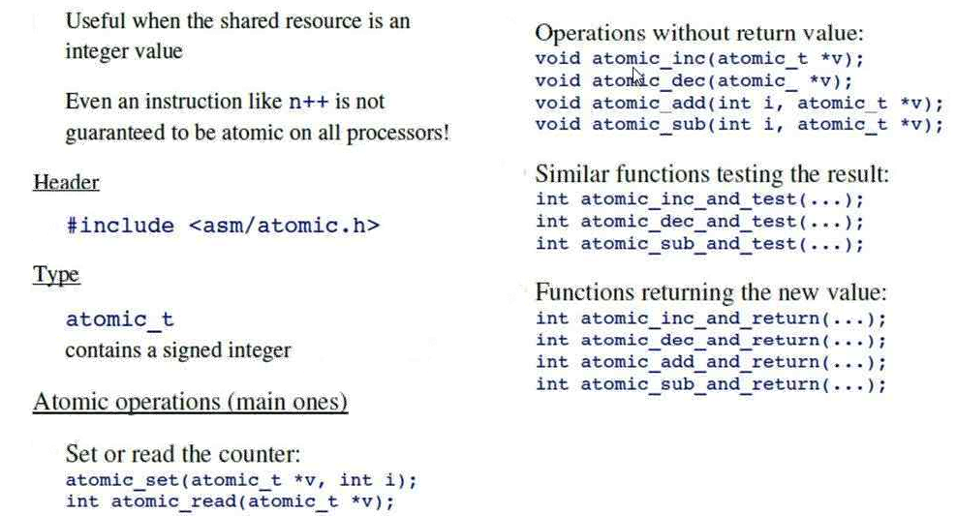
Atomic Operations:

Slide 8
Atomic bit wise operators:
<asm/bitops.h>
void set_bit(int nr, void *addr); void clear_bit(int nr, void *addr);
void change_bit(int nr, void *addr); int test_and_set_bit(int nr, void *addr);
int test_and_clear_bit(int nr, void *addr);
int test_and_change_bit(int nr, void *addr);
int test_bit(int nr,void *addr); int find_first_bit(unsigned long *addr, unsigned int size);
int find_first_zero_bit(unsigned long *addr, unsigned int size);
Locking & Unlocking Mutex

Slide 9
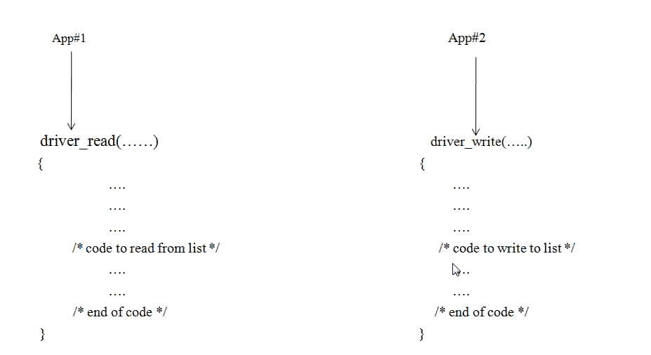
Race condition:

Slide 10
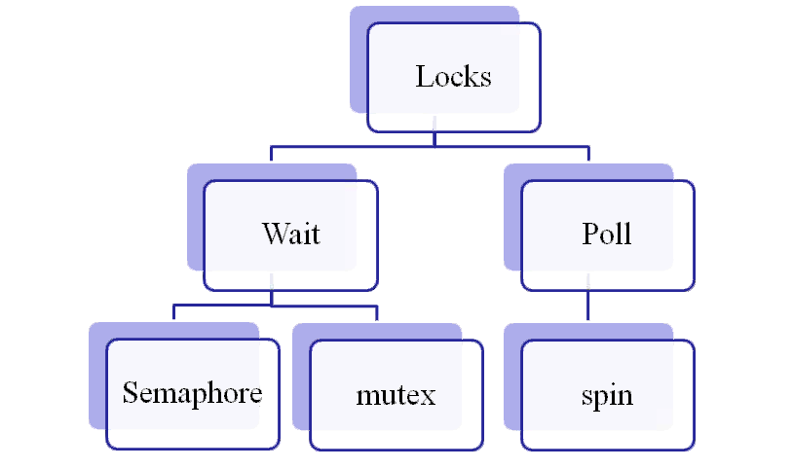
Mutual Exclusion Using locks

Slide 11
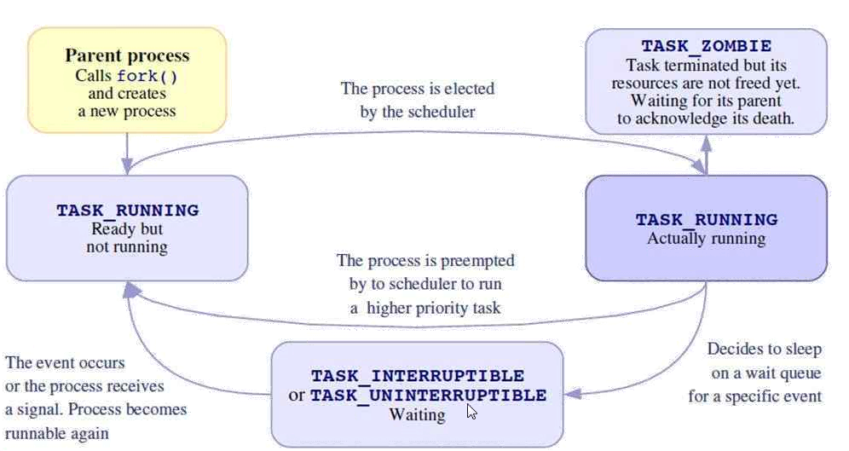
Task States:

Slide 12
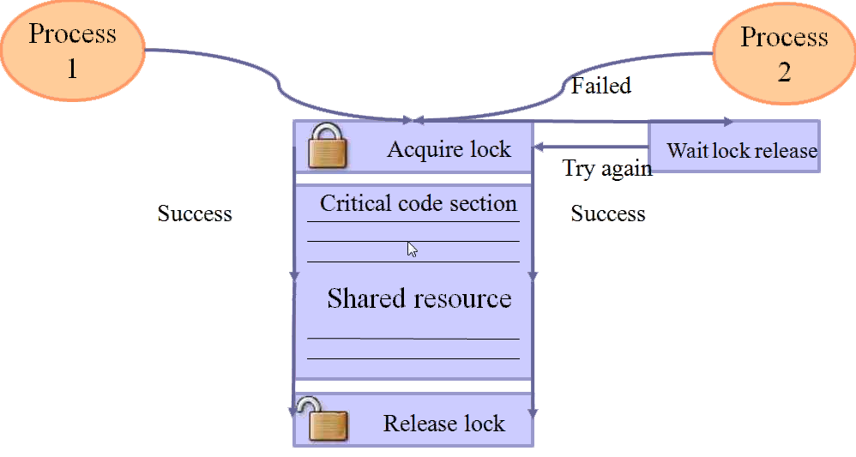
Concurrency protection with Locks

Slide 13
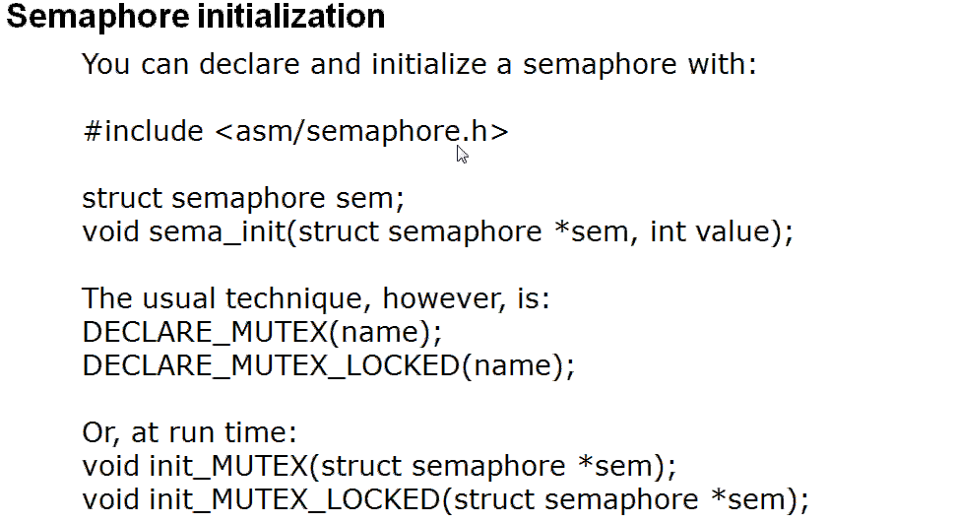

Slide 14
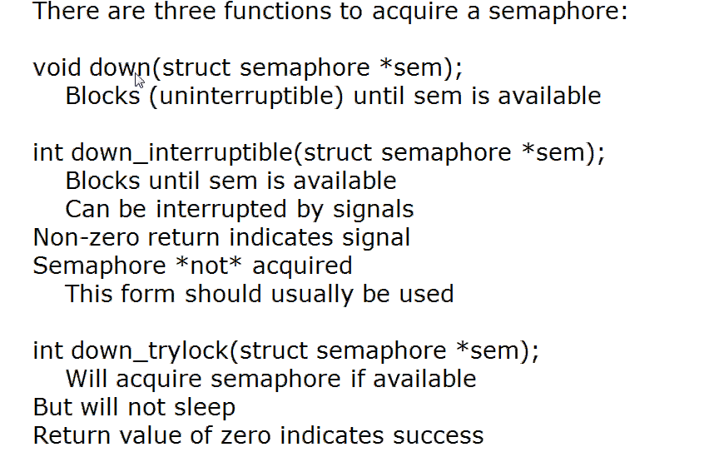
Releasing Semaphore:
A semaphore released with
Void up (struct semaphore *sem);

Slide 15
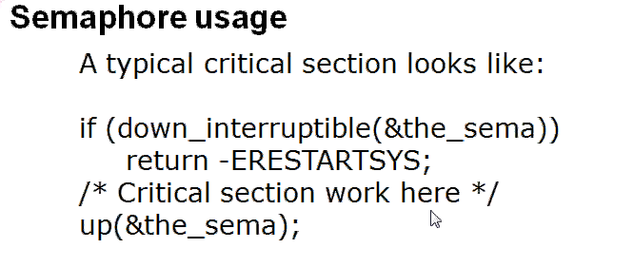
DECLARE_COMPLETION(my_completion);
Or, if the completion must be created and initialized dynamically:
struct completion my_completion;
/* ... */
init_completion(&my_completion);
Waiting for the completion is a simple matter of calling:
void wait_for_completion(struct completion *c);
Note that this function performs an uninterruptible wait. If your code calls wait_for_completion and nobody ever completes the task, the result will be an unkillable process.* On the other side, the actual completion event may be signalled by calling one of the following:
void complete(struct completion *c);
void complete_all(struct completion *c);

Slide 16
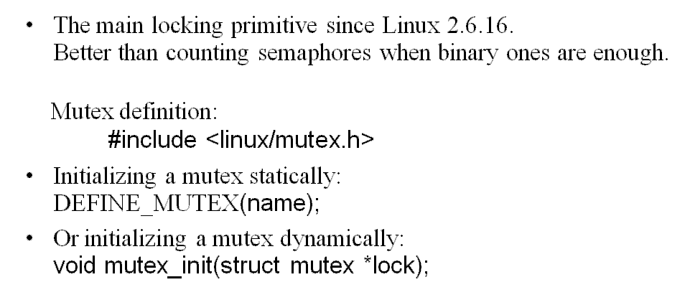

Slide 17
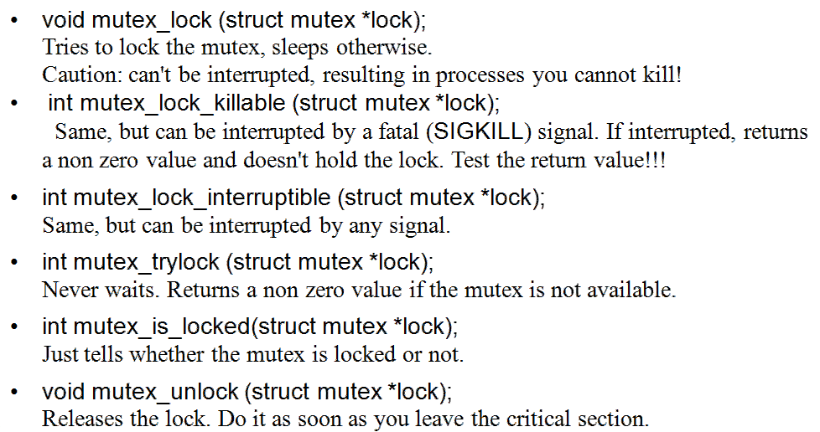
CONFIG_DEBUG_MUTEXES

Slide 18
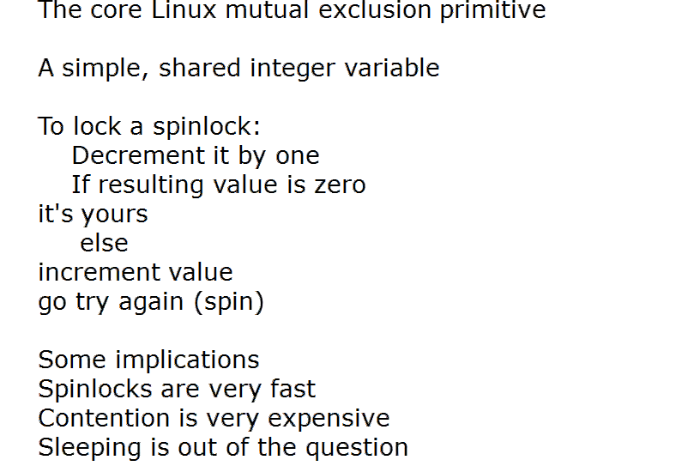
Is the critical section running in an atomic (interrupt) context or in a process context where it cannot sleep? Use the spinlock.
Is the critical section running in a process context and sleep in the
critical section is necessary? Use the mutex lock.
CONFIG_DEBUG_ATOMIC_SLEEP

Slide 19
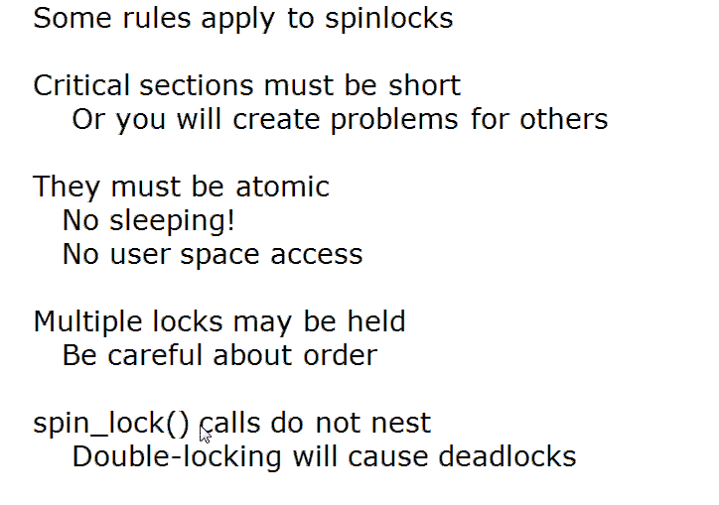

Slide 20
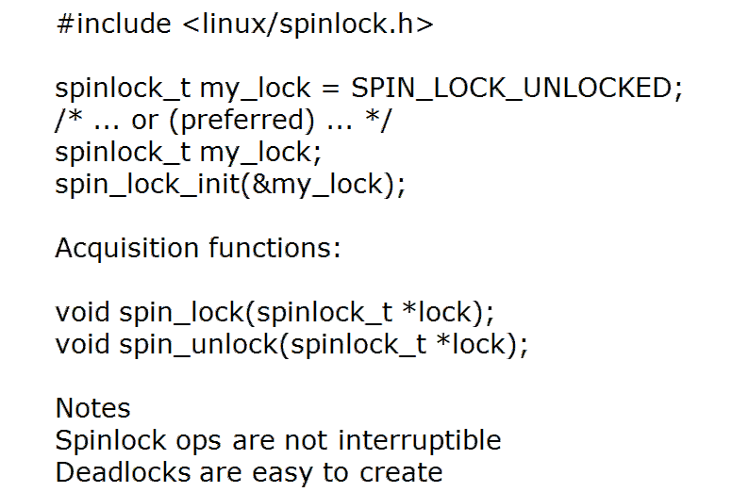

Slide 21
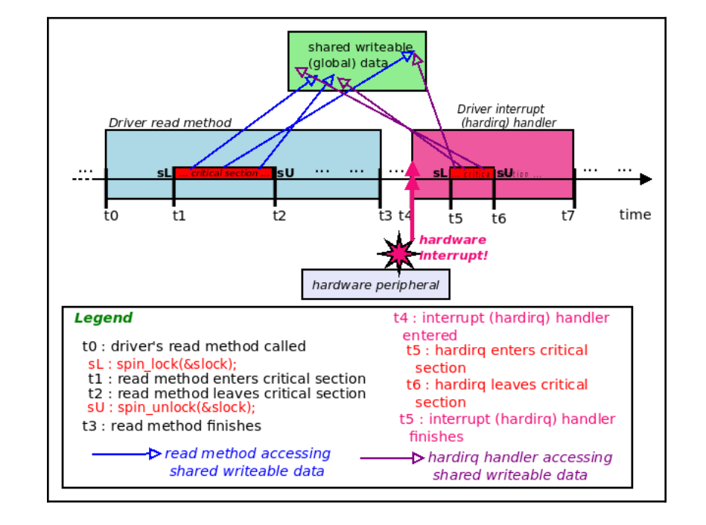

Slide 22
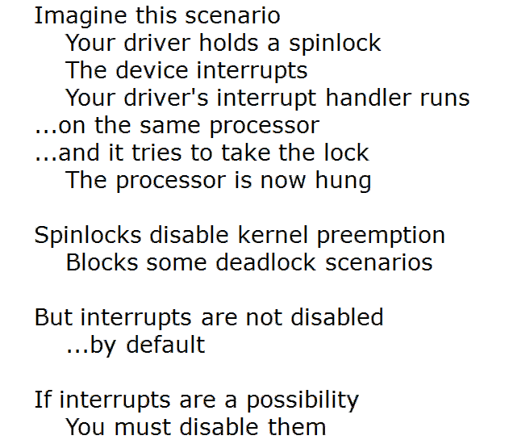
Spin Lock and Interrupts:
Interestingly, the spinlock is more intuitive and makes sense on an SMP (multicore) system. Let's assume that the read method is running on CPU core 1; the interrupt can be delivered on another CPU core, say core 2. The interrupt code path will "spin" on the lock on CPUcore 2, while the read method, on core 1, completes the critical section and then unlocks thespinlock, thus unblocking the interrupt handler. But what about on UP (uniprocessor, with only one CPU core)

Slide 23
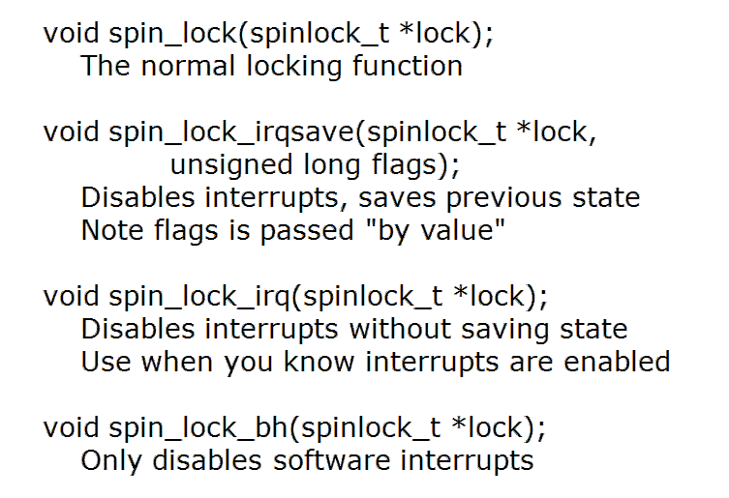

Slide 24
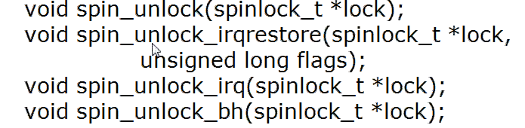
What about if a tasklet or a softirq (a bottom-half interrupt mechanism) has a critical section that "races" with your process-context code paths? In such situations, using the
spin_lock_bh() routine is likely what's required since it can disable bottom halves on the
local processor and then take the spinlock, thus safeguarding the critical section
(similar to the way that spin_lock_irq[save]() protects the critical section in the process context by disabling hardware interrupts on the local core):
void spin_lock_bh(spinlock_t *lock);
Simplest, lowest overhead: Use the non-irq spinlock
primitives, spin_lock() / spin_unlock() , when protecting critical sections in the process context (there's either no interrupts to deal with or there are interrupts, but we do not race with them at all; in effect, use this when interrupts don't come into play or don't matter).

Slide 25
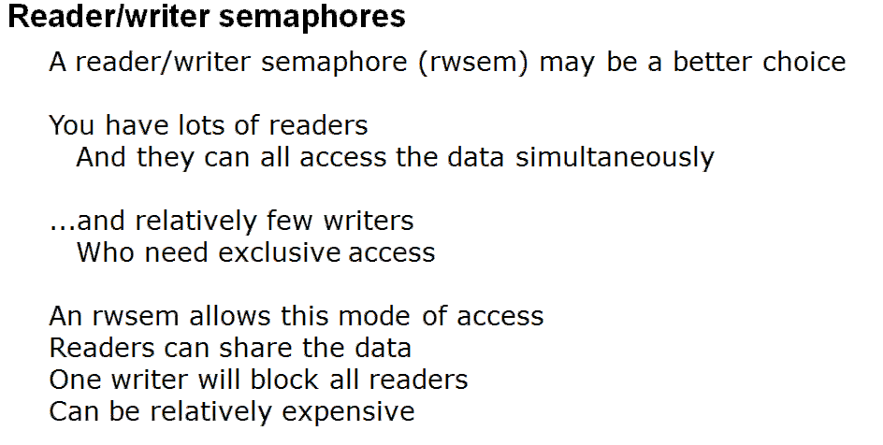
Medium overhead: Use the irq-disabling (as well as kernel preemption disabling) versions, spin_lock_irq() / spin_unlock_irq() , when interrupts are in play and do matter (the process and interrupt contexts can "race"; that is, they share global data). Strongest (relatively), high overhead: This is the safest way to use a spinlock. It does the same as the medium overhead, except it performs a save-and-restore on the interrupt mask via the spin_lock_irqsave() / spin_unlock_irqrestore() pair, so as to guarantee that the previous interrupt mask settings aren't inadvertently overwritten, which could happen with the previous case.
Concurrent access to a shared resource is not a problem if all concurrent accesses are read-only accesses. That is no one is modifying it. So it is OK to allow concurrent read accesses to a shared resource. But if a write access is going on, no other readers as well as writers should not be allowed. There may be instances where some paths are doing only read operations other code paths are doing write operations. For such situations, the kernel provides Reader-Writer spin lock facility.

Slide 26
Read/Write Spin LOCK:
DEFINE_RWLOCK(my_lock);
rwlock_t my_rwlock = RW_LOCK_UNLOCKED;
void rwlock_init(rwlock_t *lock);
void read_lock(rwlock_t *lock);
void read_lock_irq(rwlock_t *lock);
void read_lock_irqsave(rwlock_t *lock, unsigned long flags);
void read_lock_bh(rwlock_t *lock);
void read_unlock(rwlock_t *lock);
void read_unlock_irq(rwlock_t *lock);
void read_unlock_irqrestore(rwlock_t *lock, unsigned long flags);
void read_unlock_bh(rwlock_t *lock);
void write_lock(rwlock_t *lock);
void write_lock_irq(rwlock_t *lock);
void write_lock_irqsave(rwlock_t *lock, unsigned long flags);
void write_lock_bh(rwlock_t *lock);
int write_trylock(rwlock_t *lock);
void write_unlock(rwlock_t *lock);
void write_unlock_irq(rwlock_t *lock);
void write_unlock_irqrestore(rwlock_t *lock, unsigned long flags);
void write_unlock_bh(rwlock_t *lock);

Slide 27
Asynchronous I/O:
Some applications may use signal driven I/O programming. In this model application will install a SIGIO signal handler and enables the signal driven I/O by a device driver. Now onwards, whenever data is available with the device the driver will send a signal to this application process. In this model application process registers its process ID (PID) with the kernel. The driver sends the signal to this PID whenever it receives the data
Case Study:
Critical section present only in process context on a Uniprocessor (UP) box running a non preemptible kernel.
This is the simplest case and needs no locking,
Critical section present in process and interrupt contexts on a UP machine running a non preemptible kernel.
In this case, you need to disable only interrupts to protect the critical region. because of no preemption there is no threat from process context switching
Critical section present in process and interrupt contexts on a UP machine running a preemptible kernel.
If preemption is enabled, mere disabling of interrupts won't protect your critical region from being trampled over. There is the possibility of multiple threads simultaneously entering the critical section in process context. The solution apparently, is to disable kernel preemption before the start of the critical section and reenable it at the end, in addition to disabling/reenabling interrupts.

Slide 28
/* Disable interrupts - this implicitly disables preemption */
spin_lock_irqsave(&mylock, flags);
/* ... Critical Section ... */
/* Restore interrupt state to what it was at Point A */
spin_unlock_irqrestore(&mylock, flags);
Critical section present in process and interrupt contexts on an SMP machine running a preemptible kernel.
/*
- Save interrupt state on the local CPU
- Disable interrupts on the local CPU. This implicitly disables
preemption.
- Lock the section to regulate access by other CPUs
*/
spin_lock_irqsave(&mylock, flags);
/* ... Critical Section ... */
/*
- Restore interrupt state and preemption to what it
was at Point A for the local CPU
- Release the lock
*/
spin_unlock_irqrestore(&mylock, flags);

Slide 29
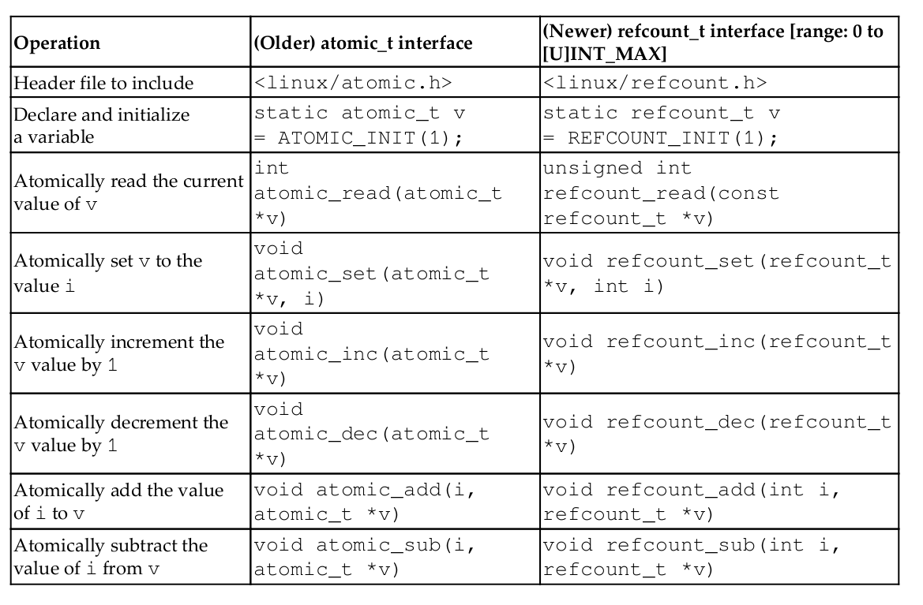
A key difference between the atomic_t operators and the refcount_t ones is that the former works upon signed integers whereas the latter is essentially designed to work upon only an unsigned int quantity; more specifically, and this is important, it works only
within a strictly specified range: 1 to UINT_MAX-1 (or [1..INT_MAX] when !CONFIG_REFCOUNT_FULL). The kernel has a config option named CONFIG_REFCOUNT_FULL; if set, it performs a (slower and more thorough) "full" reference count validation. This is beneficial for security but can result in slightly degraded Performance.
Several of the newer refcount APIs do provide memory ordering guarantees; in particular the refcount_t APIs – as compared to their older atomic_t cousins.

Slide 30
Here is a list of do's and don'ts for code executing in interrupt context:
1. It's a jailable offense if your interrupt context code goes to sleep. Interrupt handlers cannot relinquish the processor by calling sleepy functions such as schedule_timeout(). Before invoking a kernel API from your interrupt handler, penetrate the nested invocation train and ensure that it does not internally trigger
a blocking wait. For example, input_register_device() looks harmless from the surface, but tosses a call to kmalloc() under the hood specifying GFP_KERNEL as an argument. if your system's free memory dips below a watermark, kmalloc() sleep-waits for memory to get freed up by the swapper, if you invoke it in this manner.
2. For protecting critical sections inside interrupt handlers, you can't use mutexes because they may go to sleep. Use spinlocks instead, and use them only if you must.

Slide 31
3. Interrupt handlers cannot directly exchange data with user space because they are not connected to user land via process contexts. This brings us to another reason why interrupt handlers cannot sleep: The scheduler works at the granularity of processes, so if interrupt handlers sleep and are scheduled out, how can they be put back into the run queue?
4. Interrupt handlers are supposed to get out of the way quickly but are expected to get the job done. To circumvent this Catch-22, interrupt handlers usually split their work into two. The slim top half of the handler flags an acknowledgment claiming that it has serviced the interrupt but, in reality, offloads all the hard work to a fat bottom half. Execution of the bottom half is deferred to a later point in time when all interrupts are enabled. You will learn to develop bottom halves while discussing softirqs and tasklets later.
4. You need not design interrupt handlers to be reentrant. When an interrupt handler is running, the corresponding IRQ is disabled until the handler returns. So, unlike process context code, different instances of the same handler will not run simultaneously on multiple processors.
5. Interrupt handlers can be interrupted by handlers associated with IRQs that have higher priority. You can prevent this nested interruption by specifically requesting the kernel to treat your interrupt handler as a fast handler. Fast handlers run with all interrupts disabled on the local processor. Before disabling interrupts or labeling your interrupt handler as fast, be aware that interrupt-off times are bad for system performance. More the interrupt-off times, more is the interrupt latency, or the delay before a generated interrupt is serviced. Interrupt latency is inversely proportional to the real time responsiveness of the system.

Slide 32
A thread is an execution path; it's purely concerned with executing a given function. That
function is its life and scope; once it returns from that function, it's dead. In user space, a
thread is an execution path within a process; processes can be single or multi-threaded.
Kernel threads are very similar to user mode threads in many respects. In kernel space, a thread is also an execution path, except that it runs within the kernel VAS, with kernel
privilege
-> They always execute in kernel VAS, in kernel mode with kernel privilege.
->They always run in process context and they have a task
structure (and thus a PID and all other typical thread attributes, though their
credentials always are set to 0 , implying root access).
->They compete for the CPU resource with other threads (including user mode threads) via the CPU scheduler; kernel threads (often abbreviated as kthreads)
do get a slight bump in priority. Since they run purely in kernel VAS, they're blind to user VAS; thus, theircurrent->mm value is always NULL (indeed, it's a quick way to identify a kthread).
kernel threads are used for specific purposes and their name reflects that; for example, irq/%d-%s (where %d is the PID and %s is the name) is a threaded interrupt handler
Next, by default, the kernel thread runs with root ownership and all signals are masked.
However, as a simple test case, we can turn on a couple of signals via the allow_signal() helper routine.
Here, within the cleanup code path, you're expected to call kthread_stop() , which
performs the necessary cleanup. Internally, it actually waits for the kthread to die (via the wait_for_completion() routine)

Slide 33
Kernel Threads:
A thread is created by the call to the function struct task_struct *kthread_create(int (*function)(void *data),void *data,const char name[],...)
kthread_run — create and wake a thread.
struct task_struct *kthread_run(int (*threadfn)(void *data), void *data,
const char *namefmt, ...)
The kthread_should_stop() routine returns a Boolean value that's true if the kthread
should stop (terminate) now! Calling kthread_stop() in the cleanup code path will cause
kthread_should_stop() to return true, thus causing our kthread to break out of the
while loop and terminate via a simple return 0; . This value ( 0 ) is passed back to
kthread_stop() . Due to this, the kernel module is successfully unloaded, even if no signal
is ever sent to our kernel thread.
If a thread is a long run thread, we need to check kthread_should_stop everytime, becauase any function may call kthread_stop, that time kthread_should_stop will return true. If your thread is not running long, then left that thread finish its task and kill itself using do_exit
Execute the program in kthread ,AsyncIO folder

Slide 34
Per-CPU variables are also roughly analogous to the user space Pthreads Thread Local Storage (TLS) implementation where each thread automatically obtains a copy of the (TLS) variable marked with the __thread keyword.
The access and manipulation of a per-CPU variable is guaranteed to remain on
one particular CPU core; this eliminates expensive cache effects such as cache
ping-pong and false sharing
DEFINE_PER_CPU(int, pcpa);

Slide 35
Kernel synchrinzation on multicores

Slide 36
The piece of code containing the concurrency issue is called a critical region. And especially since Linux starting running on SMP machines, they became one of the major issues in kernel design and implementation.
Preemption can have the same effect, even if there is only one CPU: by preempting one task during the critical region, we have exactly the same race condition. In this case the thread which preempts might run the critical region itself.
The solution is to recognize when these simultaneous accesses occur, and use locks to make sure that only one instance can enter the critical region at any time. There are many friendly primitives in the Linux kernel to help you do this.
There are two main types of kernel locks.
-> The fundamental type is the spinlock (include/asm/spinlock.h), which is a very simple single-holder lock: if you can get the spinlock, you keep trying (spinning) until you can. Spinlocks are very small and fast, and can be used anywhere.
->The second type is a mutex (include/linux/mutex.h): it is like a spinlock, but you may block holding a mutex. If you cant lock a mutex, your task will suspend itself, and be woken up when the mutex is released. This means the CPU can do something else while you are waiting.
For kernels compiled without CONFIG_SMP, and without CONFIG_PREEMPT spinlocks do not exist at all. This is an excellent design decision: when no-one else can run at the same time, there is no reason to have a lock. If the kernel is compiled without CONFIG_SMP, but CONFIG_PREEMPT is set, then spinlocks simply disable preemption, which is sufficient to prevent any races.
Locking Between User Context
If you have a data structure which is only ever accessed from user context, then you can use a simple mutex (include/linux/mutex.h) to protect it. This is the most trivial case: you initialize the mutex. Then you can call mutex_lock_interruptible() to grab the mutex, and mutex_unlock()Âto release it. There is also a mutex_lock(), which should be avoided, because it will not return if a signal is received.
Locking Between User Context and Softirqs
If a softirq shares data with user context, you have two problems. Firstly, the current user context can be interrupted by a softirq, and secondly, the critical region could be entered from another CPU. This is where spin_lock_bh() (include/linux/spinlock.h) is used. It disables softirqs on that CPU, then grabs the lock. spin_unlock_bh() does the reverse. Note that you can also use spin_lock_irq() or spin_lock_irqsave() here, which stop hardware interrupts as well.
This works perfectly for UP as well: the spin lock vanishes, and this macro simply becomes local_bh_disable() (include/linux/interrupt.h), which protects you from the softirq being run.

Slide 37
Locking Between User Context and Tasklets
This is exactly the same as Softirq, because tasklets are actually run from a softirq.
Locking Between User Context and Timers
This, too, is exactly the same as above, because timers are actually run from a softirq. From a locking point of view, tasklets and timers are identical.
Locking Between Tasklets/Timers
Sometimes a tasklet or timer might want to share data with another tasklet or timer.
The Same Tasklet/Timer
Since a tasklet is never run on two CPUs at once, you dont need to worry about your tasklet being reentrant (running twice at once), even on SMP.
Different Tasklets/Timers
If another tasklet/timer wants to share data with your tasklet or timer , you will both need to use spin_lock() and spin_unlock() calls. spin_lock_bh() is unnecessary here, as you are already in a tasklet, and none will be run on the same CPU.
Locking Between Softirqs
Often a softirq might want to share data with itself or a tasklet/timer.
The Same Softirq
The same softirq can run on the other CPUs: you can use a per-CPU array for better performance. If you are going so far as to use a softirq, you probably care about scalable performance enough to justify the extra complexity. You will need to use spin_lock() and spin_unlock() for shared data.
Different Softirqs
You will need to use spin_lock() and spin_unlock() for shared data, whether it be a timer, tasklet, different softirq or the same or another softirq: any of them could be running on a different CPU.

Slide 38
Locking Between Hard IRQ and Softirqs/Tasklets
If a hardware irq handler shares data with a softirq, you have two concerns. Firstly, the softirq processing can be interrupted by a hardware interrupt, and secondly, the critical region could be entered by a hardware interrupt on another CPU. This is where spin_lock_irq() is used. It is defined to disable interrupts on that cpu, then grab the lock. spin_unlock_irq() does the reverse.
The irq handler does not to use spin_lock_irq(), because the softirq cannot run while the irq handler is running: it can use spin_lock(), which is slightly faster. The only exception would be if a different hardware irq handler uses the same lock: spin_lock_irq() will stop that from interrupting us.
This works perfectly for UP as well: the spin lock vanishes, and this macro simply becomes local_irq_disable() (include/asm/smp.h), which protects you from the softirq/tasklet/BH being run.
spin_lock_irqsave() (include/linux/spinlock.h) is a variant which saves whether interrupts were on or off in a flags word, which is passed to spin_unlock_irqrestore(). This means that the same code can be used inside an hard irq handler (where interrupts are already off) and in softirqs (where the irq disabling is required).
Note that softirqs (and hence tasklets and timers) are run on return from hardware interrupts, so spin_lock_irq() also stops these. In that sense, spin_lock_irqsave() is the most general and powerful locking function.
Locking Between Two Hard IRQ Handlers
It is rare to have to share data between two IRQ handlers, but if you do, spin_lock_irqsave() should be used: it is architecture-specific whether all interrupts are disabled inside irq handlers themselves.

Slide 39
